Slide 1
Micro Economics and its application

Slide 2
General Economics
Economics is based on a simple problem:
  Resources are scarce
  Human wants are infinite
Trade off!
Opportunity cost
  “The cost of the next best opportunity foregone.”
  Not literally a cost in terms of money

Slide 3
Wee need to know basics of:
Economic Goods - scarce relative to our wants
Derived Demand
Utility
Diminishing marginal returns

Slide 4
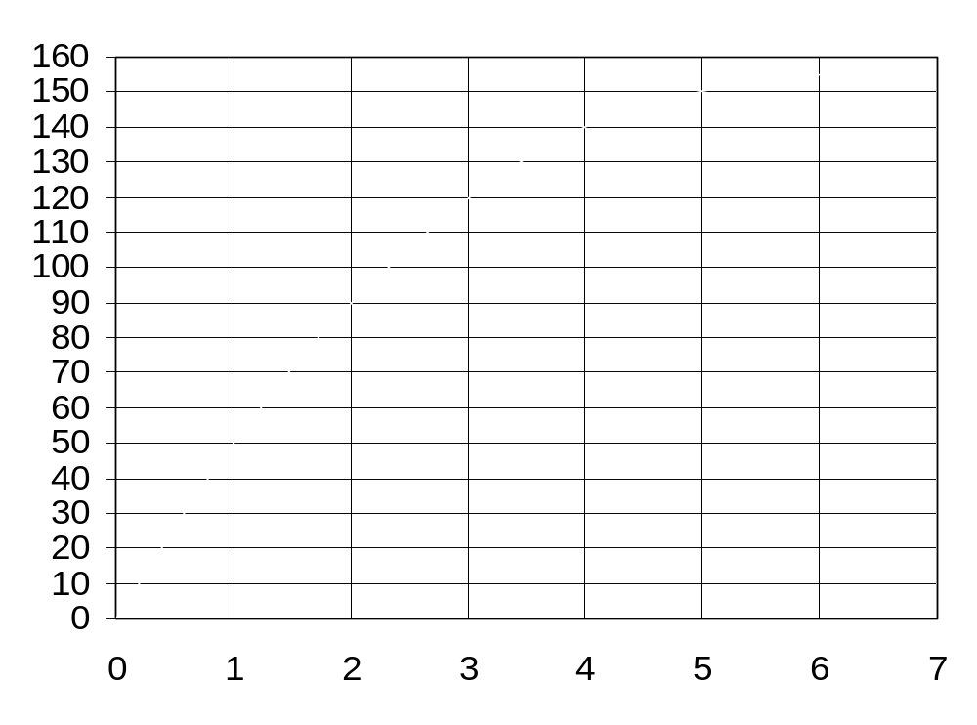
Diminishing Marginal Returns
Utility
Number of chocolates eaten

Slide 5
Indifference curves
Marginal Rate of Substitution...
Basically if you were going to reduce the amount of nurses, how many more doctors would you need to maintain the same amount of utility
Kit Kat
c
Y₃=9
Y₁=7
a
b
U₂
Y₂=5
Y₄=3
U₁
X₁=5
X₂=8
X₃=10
X₄15
Kinder Bueno
Notes:
Figure 2.1 Indifference curves

Slide 6
Maximising utility when constrained by a budget
Kit Kats
[Good Y]
40
Y₁
d
e
Y₂
U₂
U₁
0
X₁
X₂
40
20
Kinder Bueno
[Good X]

Slide 7
Utility Maximisation
  MU_{n}/P_{n} = MU_{gp}/P_{gp (…wtf)}
MU/P means PRICE per unit of SATISFACTION
Marginal utility means the utility you get from consuming one more of the product
If the MU/P for KitKats was cheaper than MU/P for Kinder Bueno, you would buy more Kitkats because you could get more satisfaction (utility)
However, the more you have of something, the less added satisfaction you get by having one more
Marginal utility goes down...it becomes more expensive to get one more unit of utility by having more Kitkat
Eventually it will become the same price for a unit of utility...this is utility maximisation
MU_{n}/MU_{gp} = P_{n}/P_{gp …}Makes sense when you look at that graph again

Slide 8
Firms - Minimise costs of production + maximise profit
Profit = Total Revenue (TR) – Total Cost (TC)
Profit Maximisation:
  Marginal Cost (MC) = Marginal Revenue (MR)
Diminishing marginal product – same principle as diminishing marginal utility
Meaning that...

Slide 9
Quantity of output
Number of Workers Hired
Notes:
Diminishing Marginal Product
The slope of the production function measures the marginal product of an input, such as a worker.
When the marginal product declines, the production function becomes flatter.

Slide 10
Q₂₀₀
Number of
nurses
INPUTS!
What’s the least number of workers you can get away with treating 200 patients.
A
B
Q₂₀₀
0
Number of doctors
Number of outpatient
procedures
B
OUTPUTS!
What’s the max number of procedures you can do with a fixed number of workers
A
0
Number of inpatient procedures

Slide 11
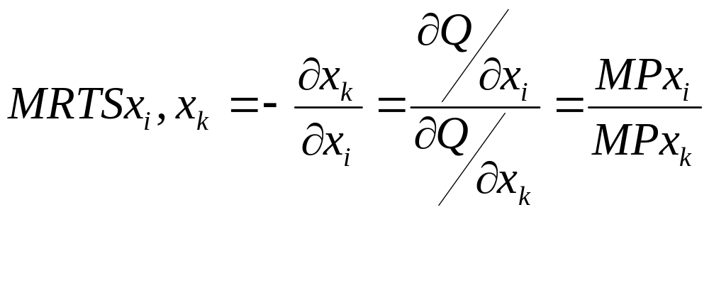
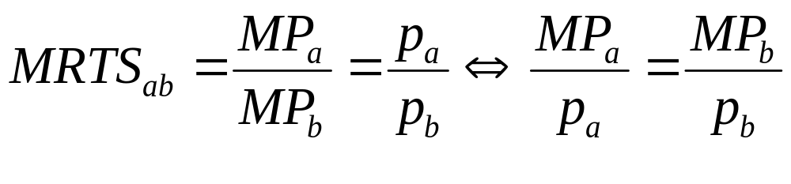
Marginal Rate of Technical Substitution
...eh?!
Think of it as the supply side version of marginal rate of substitution that you get with the utility curves early on.

Slide 12
Maximizing output to a budget constraint
Q₀
Q₁
Q₂
Number of nurses
N₁
N*
E
Q₂
Q₁
Q₀
Number of doctors
0
D*
D₁

Slide 13
Demand
Demand – consumers
How much consumers are WILLING and ABLE to buy at any given price
SHIFT vs MOVEMENT – PIRATE
Population, Income, Related goods, Alternative, Tastes and fashion, Expectations
Normal vs Inferior good

Slide 14
Co-insurance
Price per
visit
d_{WI}
“Nominal”
demand
$300
d_{WO}
$150
“Effective”
demand
$50
$25
Number of visits
5
10
15

Slide 15
Supply
Supply – producers
SHIFT vs MOVEMENT – CREWS
Complements, Raw materials, Expectations for future, Weather, Substitutes.

Slide 16
Market Price
Price
Supply
Equilibrium price
Equilibrium
$20
Equilibrium
Demand
quantity
0
1
2
3
4
5
6
7
8
9
10
11
12
13
Quantity

Slide 17
Price
Price
Supply
Supply
Excess
$700
$500
$2.00
1.50
Shortage
Demand
Demand
0
4
7
10
Quantity
0
4
7
10
Quantity
Quantity
Quantity
Quantity
Quantity
demanded
supplied
supplied
demanded
Price
Price
S₂
S₁
Supply
$2.50
New equilibrium
New
$2.50
equilibrium
2.00
2.00
Initial equilibrium
Initial
equilibrium
D
Demand
D
0
7
10
Quantity
0
4
7
Quantity

Slide 18


Surplus
Price
Supply
Demand
0
Quantity
In an ideal world the price set by the market would prevail because this is where we maximise “surplus.” However, there are reasons why markets fail...

